Slide 1

Seidu Suleiman
Data Analytics Intern at Oasis Infobyte

Slide 2
Exploratory Data Analysis of Retail Sales Data
Task 1.1
Key Insights and Recommendations for Business Growth

Slide 3
Introduction
Purpose of the Analysis:
Understand sales trends, customer behavior, and product performance.
Provide actionable insights for strategic decision-making.
Dataset Overview:
Total Records: 1,000
Key Columns: Date, Customer ID, Gender, Age, Product Category, Quantity, Total Amount.

Slide 4
Methodology
• Steps Taken:
1. Data Cleaning
2. Descriptive Statistics
3. Time Series Analysis
4. Customer Demographics Analysis
5. Product Performance Analysis

Slide 5
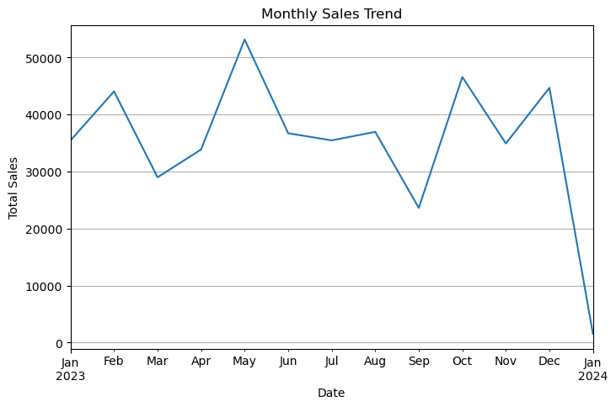
Sales Trends Over Time
Key Insights:
Identify peak and low sales months.
Correlate peaks with holidays or promotional periods.
Takeaway: Plan inventory and campaigns for high-demand periods.
Line chart showing monthly sales trends.

Slide 6
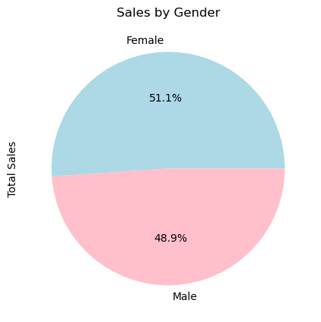
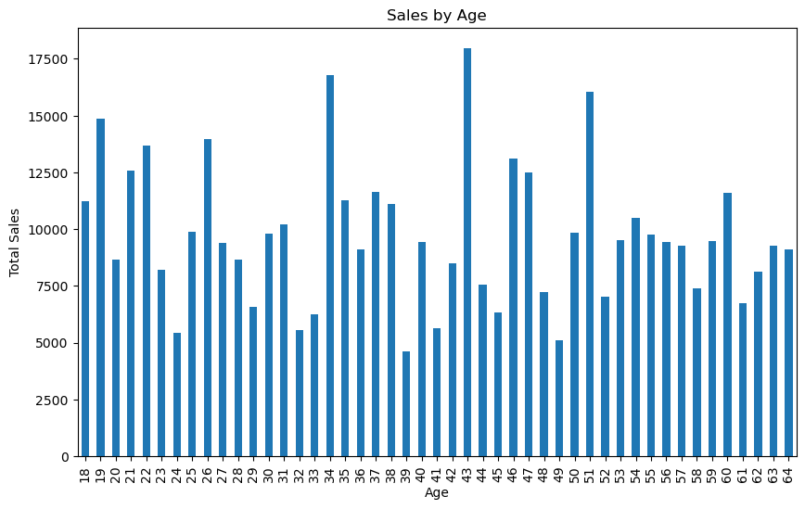
Customer Demographics
Pie chart showing sales by gender.
Bar chart for sales by age group.

Slide 7
Customer Demographics
Key Insights:
Highlight high-spending gender.
Identify top-performing age groups.
Takeaway: Focus marketing on top-performing demographics.

Slide 8
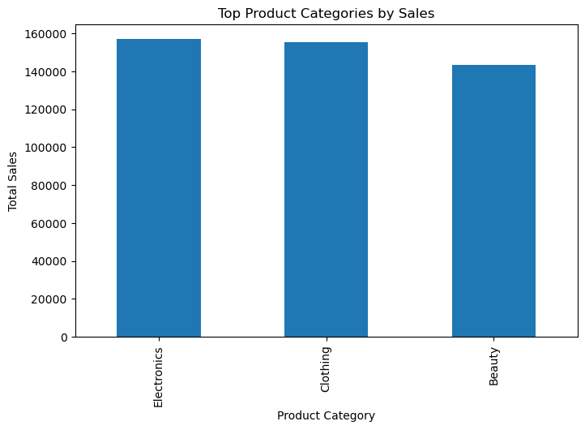
Product Performance
Key Insights:
Most revenue generated from Electronics, Clothing.
Underperforming categories identified.
Takeaway: Expand inventory for high-performing categories and evaluate low-performing ones.
Bar chart of top product categories.

Slide 9
Recommendations
• Sales Optimization:
o Target marketing campaigns for high-spending demographics.
o Stock top-selling products during peak seasons.
• Customer Engagement:
o Introduce loyalty programs for repeat customers.
o Use promotions to attract underrepresented demographics.
• Product Strategy:
o Bundle popular and underperforming products to drive sales.
o Evaluate and phase out poorly performing products.

Slide 10
Conclusion
Summary:
Monthly sales trends show peaks during certain months (February, May, October and December), these might align with holidays, seasons, or promotions.
If one gender (Female) contributes significantly more to sales, it indicates their preference for your product categories.
Focus on high-performing product categories (Electronics and clothing).
Actionable recommendations for growth:
Plan marketing campaigns and stock inventory strategically for peak months and introduce seasonal promotions or discounts to sustain sales during low-performing months.
Focus marketing efforts on the higher-spending gender group and explore ways to attract the lower-spending group, such as gender-specific discounts or promotions.
Expand inventory for top-selling categories and improve low-selling products or replace them with more popular alternatives.
Final Note:
Implementing these strategies can improve profitability and customer satisfaction.

Slide 11
Thank
You!

Slide 12

Let me know!
Email
seidusuleiman0@gmail.com
Linkedin
https://www.linkedin.com/in/suleiman-seidu-8b2135343

